Slide 1
RISK MITIGATION ANALYSIS IN LOANS: A MACHINE LEARNING PERSPECTIVE
Mili Chowdhury
Roll- C24-008

Slide 2
INTRODUCTION:
In the dynamic landscape of financial services, the challenge of optimizing loan approval processes is a critical concern for institutions seeking to enhance operational efficiency and mitigate risks. Traditional approaches often involve time-consuming manual assessments, leading to delays and increased operational costs. This project, titled "Risk Mitigation Analysis in Loans: A Machine Learning Perspective" addresses this challenge by leveraging advanced data science techniques to revolutionize the way loan applications are assessed.

Slide 3
OBJECTIVES:
Efficient Loan Approval: Develop a data-driven solution to streamline and expedite the loan approval workflow, reducing the time required for decision-making.
Risk Mitigation: Utilize machine learning models, specifically Random Forest and Decision Tree models, to assess the risk associated with loan applications. By leveraging historical data, the models aim to provide accurate predictions of the likelihood of loan approval.
Automation through Pipeline: Establish a robust pipeline that automates end-to-end machine learning processes, encompassing data preprocessing, model training, and evaluation. This pipeline enhances reproducibility, scalability, and the overall efficiency of the modeling workflow.
Business Impact: Evaluate the project's impact from a business perspective. Assess how the implementation of data-driven loan approval processes contributes to reducing the risk of defaults, increasing approval rates for eligible applicants and improving overall customer satisfaction.

Slide 4
DATASET OVERVIEW
Unique identifier for each loan application.
Number of dependents associated with the applicant.
Educational qualification of the applicant
Indicates whether the applicant is self-employed
Annual income of the applicant.
Amount of loan applied for.
Term of the loan in months.
Credit score of the applicant.
Value of residential assets owned by the applicant.
Value of commercial assets owned by the applicant.
Value of luxury assets owned by the applicant.
Value of assets held in the bank by the applicant.
Status of the loan application (Approved/Rejected).
Loan_ID: :
No_of_Dependents :
Education :
Self_Employed :
Income_Annual :
Loan_Amount :
Loan_Term :
CIBIL_Score :
Residential_Assets_Value :
Commercial_Assets_Value :
Luxury_Assets_Value :
Bank_Asset_Value :
Loan_Status :

Slide 5
DATA PREPROCESSING:
StringIndexer for Education:
StringIndexer is used to convert the categorical variable "education" into numerical indices.
The input column is "education," and the output column is "edu."
OneHotEncoder for Education:
OneHotEncoder is applied to the output of the StringIndexer ("edu").
It converts the categorical indices into a sparse vector representation (one-hot encoded vector).
The output column is named "edu_Vector."
setDropLast(False) is used to include all categories in the vector.
StringIndexer for Self Employed:
Similar to education, "self_employed" is being converted into numerical indices using StringIndexer.
The input column is "self_employed," and the output column is "self_employed1."
OneHotEncoder for Self Employed:
OneHotEncoder is applied to the output of the StringIndexer ("self_employed1").
It converts the categorical indices into a sparse vector ("self_employed1_Vector").
setDropLast(False) is used to include all categories in the vector.
StringIndexer for Loan Status:
Similarly, "loan_status" is being converted into numerical indices using StringIndexer.
The input column is "loan_status," and the output column is "loan_status1."
OneHotEncoder for Loan Status:
OneHotEncoder is applied to the output of the StringIndexer ("loan_status1").
It converts the categorical indices into a sparse vector ("loan_status1_Vector").
setDropLast(False) is used to include all categories in the vector.
VectorAssembler:
VectorAssembler is used to assemble all the features into a single vector.
The input columns include the one-hot encoded vectors ("edu_Vector," "self_employed1_Vector") and other numeric features.
The assembled feature vector is named "features.”
8. No Null Values found

Slide 6

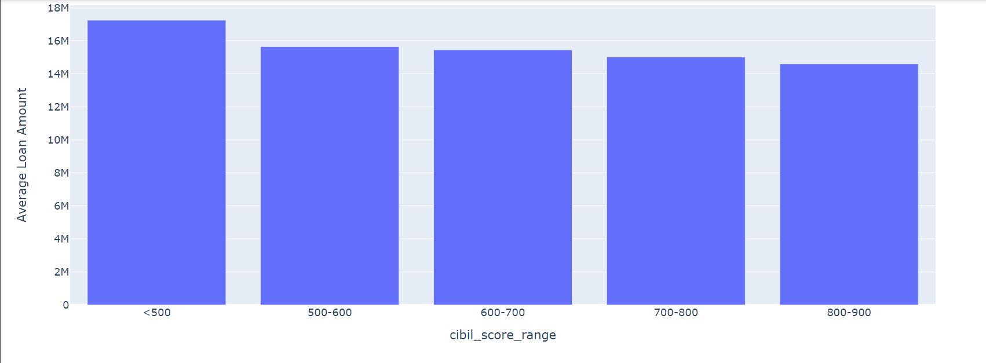
We can notice that people with lower CIBIL SCORE tends to take more loan and most gets approval.

Slide 7
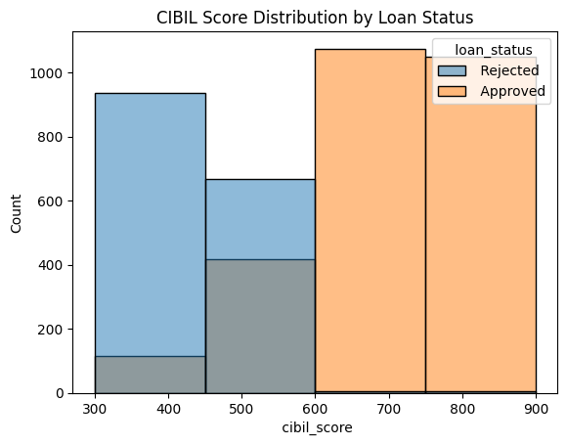
Higher CIBIL score has higher chance of securing loans.

Slide 8
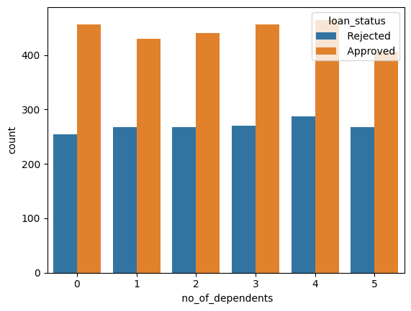
People with more number of dependents has a greater probability of securing a loan.

Slide 9
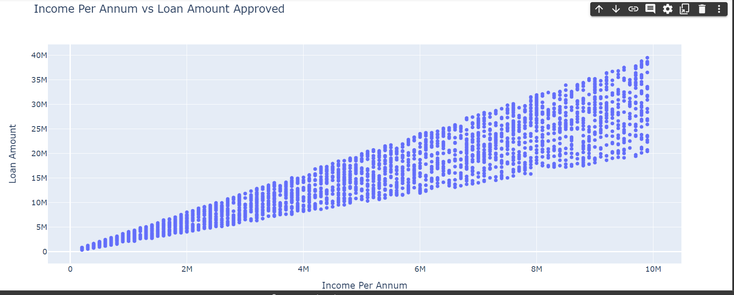
People with higher income has a greater probability of securing higher amount of loans.
Average Loan Amount: 15133450.456781447 Maximum CIBIL Score: 900 Minimum CIBIL Score: 300 Total Records: 4269

Slide 10
Decision Tree Model Performance
Model Metrics Comparison
With Pipeline:
Accuracy: 0.97
Recall: 0.99
False Positive Rate: 0.05
Insights:
The pipeline demonstrates the high level of accuracy, recall, and low false positive rate.

Slide 11
Random Forest Model Performance
Model Metrics Comparison
With Pipeline:
Accuracy: 0.96
Recall: 0.96
False Positive Rate: 0.04
Insights:
The pipeline demonstrates the same high level of accuracy, recall, and low false positive rate.

Slide 12
Gradient Boost Model Performance
Model Metrics Comparison
With Pipeline:
Accuracy: 0.97
Recall: 0.97
False Positive Rate: 0.03
Insights:
The pipeline demonstrates the same high level of accuracy, recall, and low false positive rate.

Slide 13
Random Forest vs. Decision Tree
Key Metrics Overview
Random Forest:
Accuracy (with Pipeline): 0.96
Recall (with Pipeline): 0.96
False Positive Rate (with Pipeline): 0.05
Decision Tree:
Accuracy (with Pipeline): 0.97
Recall (with Pipeline): 0.99
False Positive Rate (with Pipeline): 0.05
Comparative Analysis
Accuracy: Decision Tree and GBM outperforms the Random Forest slightly in terms of accuracy.
Recall: The Decision Tree shows a higher recall rate, indicating a better ability to identify positive instances.
False Positive Rate: All models demonstrate a low false positive rate, signifying good precision.
GBM:
Accuracy (with pipeline) : 0.97
Recall (with pipeline) : 0.97
False Positive Rate (with pipeline) : 0.03

Slide 14
CONCLUSION
Key Findings and Insights
The analysis showcased impressive performance from all 3 models.
Notable strengths include consistently high accuracy and recall rates, indicating the models' effectiveness in predicting loan outcomes.
The models exhibit robustness and reliability, instilling confidence in their application.
Challenges Faced
Despite the overall success, challenges were encountered in managing categorical values
These challenges provided valuable insights and opportunities for refinement.
Final Thoughts:
Since the False Positive Rate is so low, the model’s number of defaulters is meager. This is very important for a financial institute offering a loan since their main goal will be to recover the full loan with the interest
Continuous monitoring and periodic updates will ensure the models' sustained effectiveness.

Slide 15
THANK YOU
Mili Chowdhury
Roll: C24-008
Email: mili.Chowdhury_ds24sp@praxistech.school
Github: https://github.com/milichowdhury0096/Risk-Mitigation-Analysis-In-Loans-using-Spark

